Slide 1
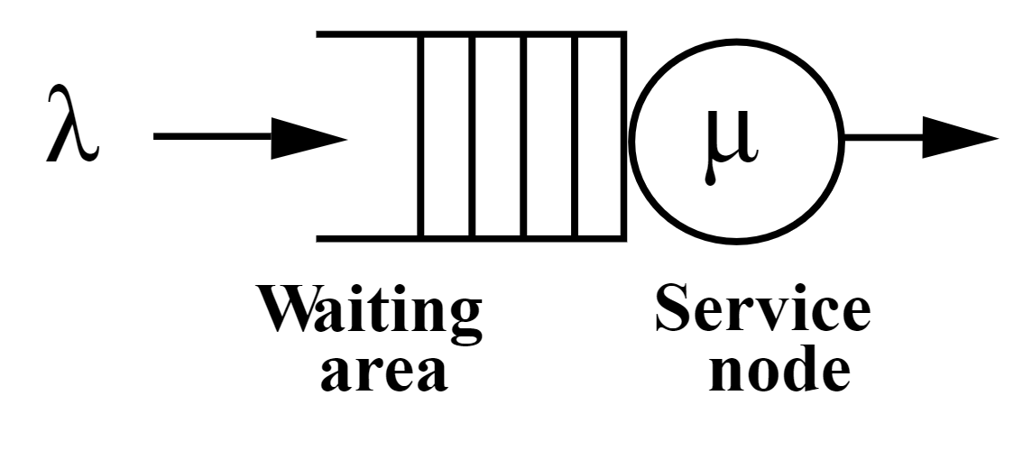
Queueing Simulations

Slide 2
Contents
Introduction (Why?)
Distributions
Kendall’s Notation
M/M/1
  Costs for customer/server
Common Queue Types
Servers in Series Example

Slide 3
Blank Slide

Slide 4
Introduction
Study of queues.
Used widely in the design of factories, hospitals, shops etc…
Applications in traffic engineering, computing, communication
Two basic approaches:
analytic methods or queuing theory (formula based); and
simulation (computer based).
Analytic methods are only available for relatively simple queuing systems. Complex queuing systems are almost always analysed using simulation (Discrete Event Simulation)

Slide 5
Queueing Theory
Analytical study of queues.
Origins in modelling the Copenhagen telephone exchange (Agner Krarup Erlang)
The simple queueing systems that can be tackled via queueing theory essentially:
consist of just a single queue; linked systems where customers pass from one queue to another cannot be tackled via queueing theory
have distributions for the arrival and service processes that are well defined (e.g. standard statistical distributions such as Poisson or Normal); systems where these distributions are derived from observed data, or are time dependent, are difficult to analyse via queueing theory

Slide 6

Queueing Node
Queue
Service
Arrival Process
Queue Characteristics
Service Mechanism
A basic queuing node has an arrival of customers/jobs which queue for a service.
Many unanswered questions, e.g.
How do customers arrive?
What is the queue capacity and type (e.g. FIFO)?
What is the number of servers and their respective service times?

Slide 7
Random Arrival Time/Service Time
We need to some how model customers arriving or being served. There are 3 ways to do this.
Deterministic
Inter-Arrival/Service time is known. i.e. a fixed value
Memoryless
Usually the Poisson (average no arrivals per time period) or Exponential (average time between arrivals)
General
Mean and variance known, e.g. Uniform, normal distribution. Think machine time, skilled worked. Times are always within bounds.

Slide 8
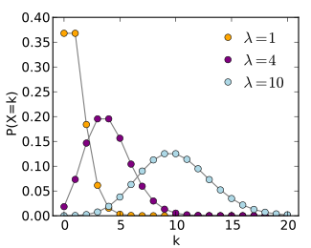

Memoryless – Poisson
Models number of arrivals per time period
Mean of $λ$
Events are independent. i.e. the probability of the next event is always the same regardless of previous events. Think coin tosses.
Many things are naturally modelled by the Poisson Distribution
The Poisson distribution may be useful to model events such as
The number of meteorites greater than 1 meter diameter that strike Earth in a year
The number of patients arriving in an emergency room between 10 and 11 pm
The number of laser photons hitting a detector in a particular time interval
e.g. for an average (mean) rate of 10 patients arriving in an emergency room between 10 and 11 pm - $λ=10$

Slide 9
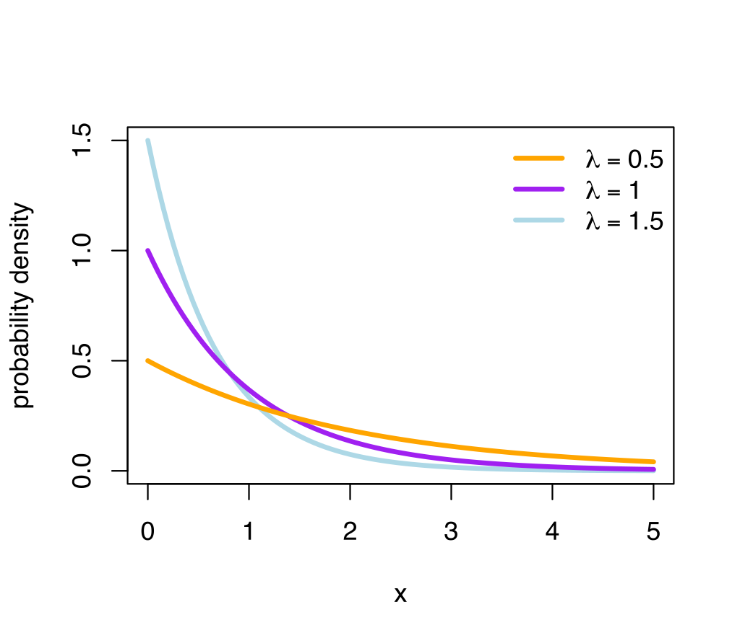

Memoryless – Exponential
Models inter-arrival time between events
Events are independent. i.e. the probability is always the same regardless of job arrival history. Think coin tosses.
Mean - $\frac{1}{λ}$
e.g. for an average (mean) rate of 10 patients arriving in an emergency room between 10 and 11 pm - $λ=10$
Therefore this distribution will generate random numbers with a mean of $\frac{1}{10}$. Which for 1 hour is every 6 minutes. So on average it generates 10 arrivals per hour!
In excel for an arrive rate of $λ$ we can generate interarrival times by:
$$−\frac{1}{λ}∗LN(RAND())$$

Slide 10
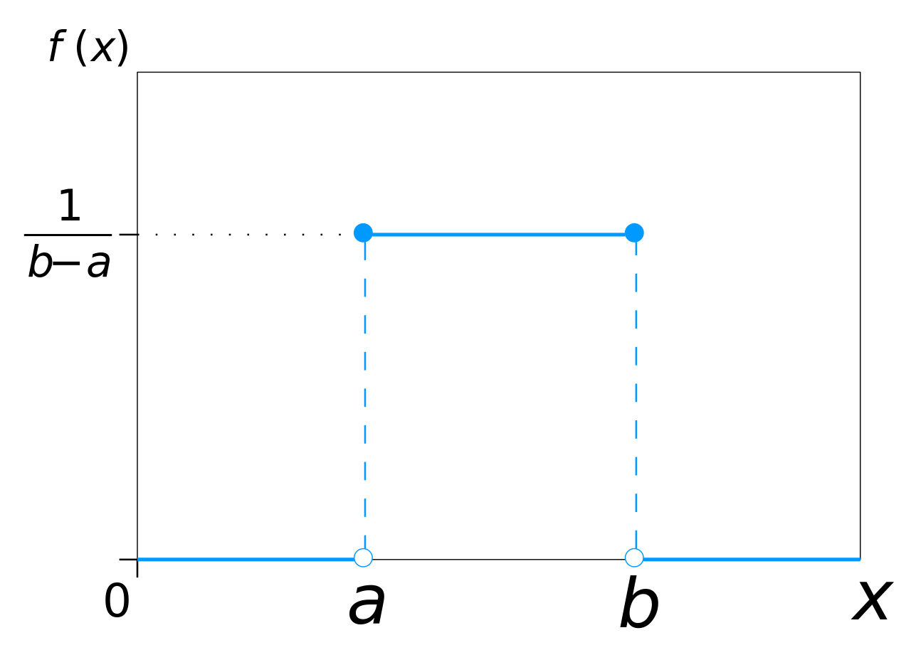

General – Uniform
Models uniform probability between min and max
Machine time could be uniformly distributed between 10 and 11.
That is, each time the machine ‘serves’ there is an equal probability of any time between 10 and 11.
Last week we used this in our simulations
e.g.
$$RAND()∗10$$
Was a uniformly distributed number between 0 and 10.
Reasonable for an inter-arrival time?

Slide 11
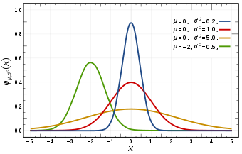
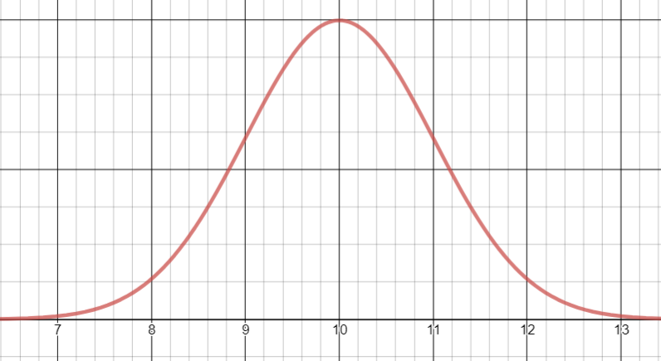

General - Normal
Models with a mean and a variance (spread of data)
Machine time could be normally distributed with mean 10 and variance 1.
Here values are most likely to fall around 10, it is highly unlikely we get values of 13 or above
Why might this be useful to model workers or machines?
It is bounded. The exponential allowed for times that would be odd!
e.g. for $λ=10$ there is nothing stopping an inter-arrival time of 0.1 or 20.
Would a skilled worker who has a mean time for their task do it instantaneously or take twice the time?

Slide 12
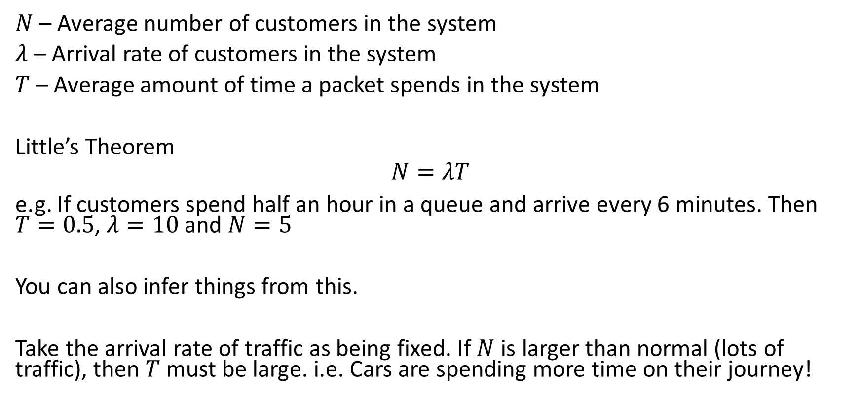
Little’s Theorem
$N$ – Average number of customers in the system
$λ$ – Arrival rate of customers in the system
$T$ – Average amount of time a packet spends in the system
Little’s Theorem
$$N=λT$$
e.g. If customers spend half an hour in a queue and arrive every 6 minutes. Then $T=0.5$, $λ=10$ and $N=5$
You can also infer things from this.
Take the arrival rate of traffic as being fixed. If $N$ is larger than normal (lots of traffic), then $T$ must be large. i.e. Cars are spending more time on their journey!

Slide 13
Kendall’s Notation
Proposed by D. G. Kendall in 1953 and since extended. Standard way to classify a queuing node
A/S/c/K/N/D
A - probability distribution for the arrival process
S - probability distribution for the service process
c - number of channels (servers)
K – queue capacity, i.e. maximum number of customers allowed in the queueing system (either being served or waiting for service)
N - maximum number of customers in total
D - queueing discipline
Common options for A and S are:
M for a Poisson distribution or exponential distribution
D for a deterministic distribution
G for a general distribution

Slide 14
M/M/1
Single server, with random arrivals and random service time
A/S/c/K/N/D
A = M (Poisson/Exponential Distribution)
S = M (Poisson/Exponential Distribution)
c = 1 (number of servers)
K = infinite (queue capacity)
N = infinite
D = FIFO (queueing discipline)
K/N/D not defined implies the above by default.
What would M/G/1/5 mean?

Slide 15
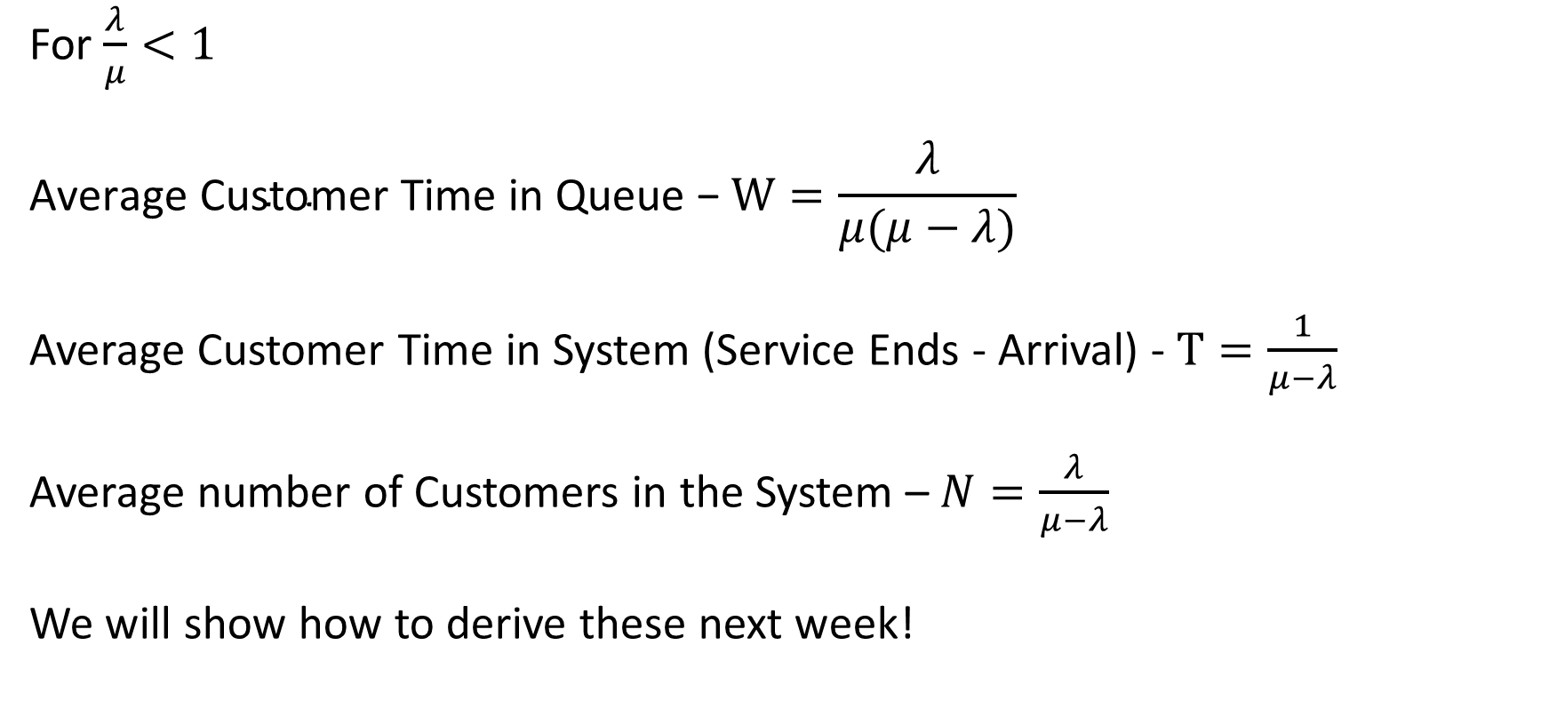
M/M/1 Formulas
For $\frac{λ}{μ}<1$
$$\text{Average} \text{Customer} \text{Time} \text{in} \text{Queue}\text{ − }W=\frac{λ}{μ(μ−λ)}$$
Average Customer Time in System (Service Ends - Arrival) - $T=\frac{1}{μ−λ}$
Average number of Customers in the System – $N=\frac{λ}{μ−λ}$
We will show how to derive these next week!

Slide 16
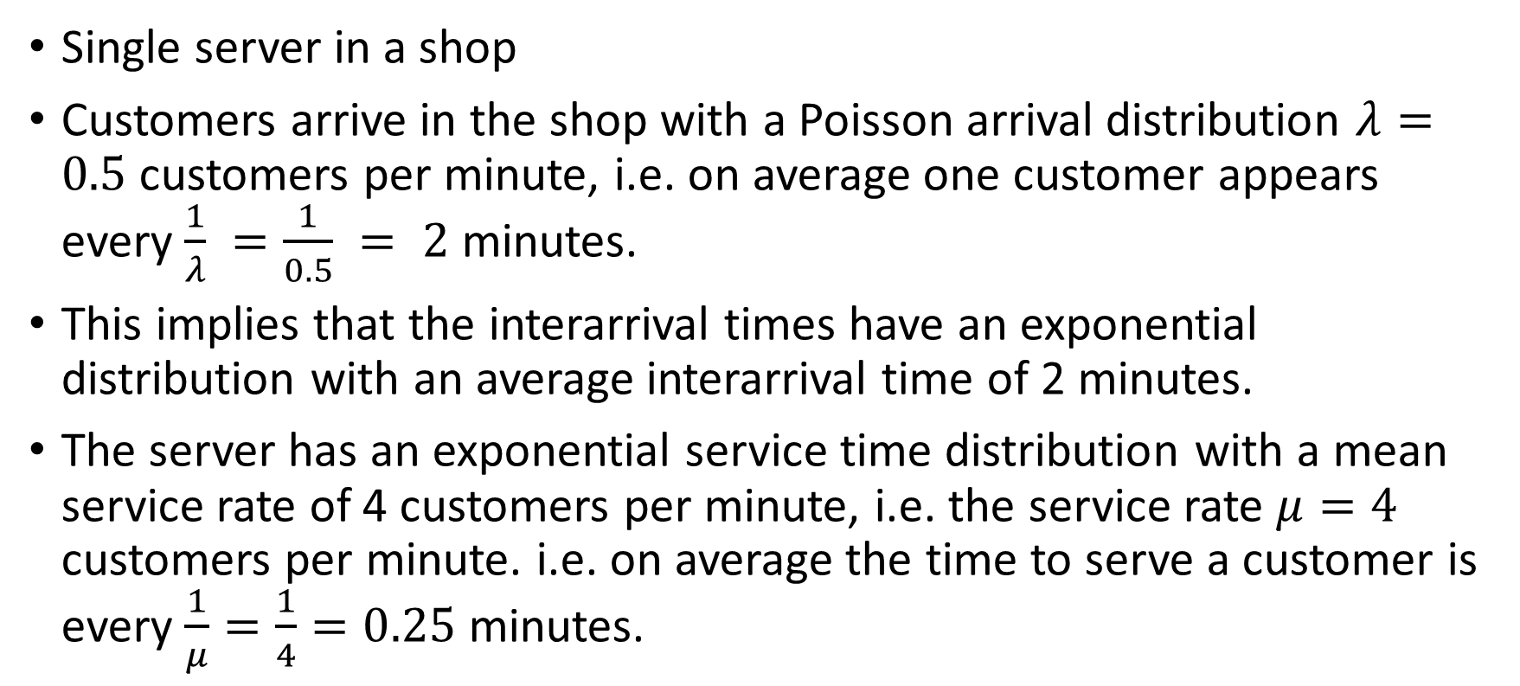
M/M/1 Example
Single server in a shop
Customers arrive in the shop with a Poisson arrival distribution $λ=0.5$ customers per minute, i.e. on average one customer appears every $\frac{1}{λ} =\frac{1}{0.5} = 2$ minutes.
This implies that the interarrival times have an exponential distribution with an average interarrival time of 2 minutes.
The server has an exponential service time distribution with a mean service rate of 4 customers per minute, i.e. the service rate $μ=4$ customers per minute. i.e. on average the time to serve a customer is every $\frac{1}{μ}=\frac{1}{4}=0.25$ minutes.

Slide 17
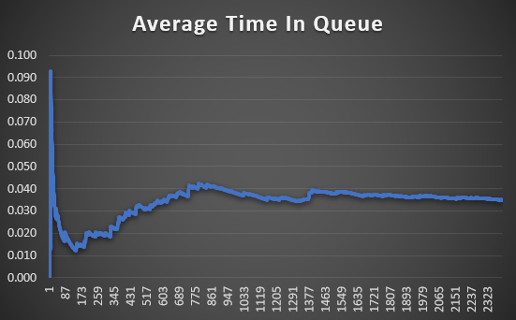
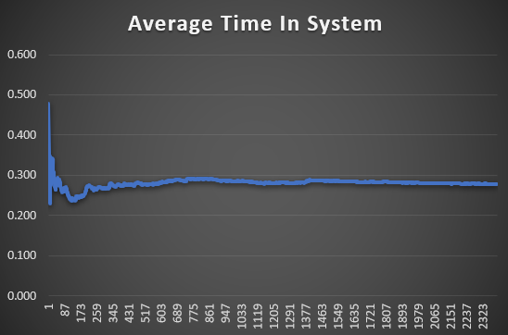
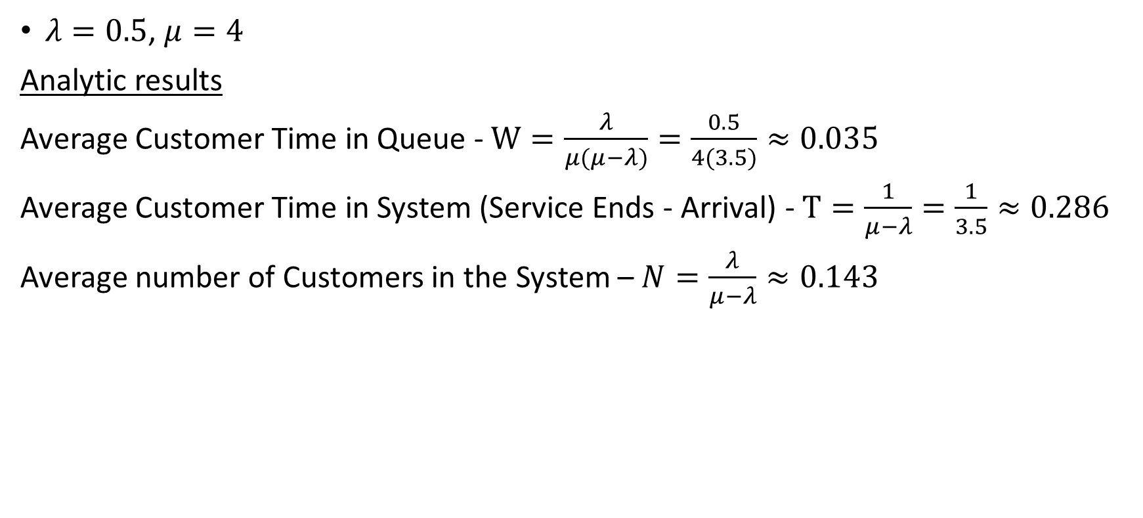
M/M/1 Example
$λ=0.5$, $μ=4$
Analytic results
Average Customer Time in Queue - $W=\frac{λ}{μ(μ−λ)}=\frac{0.5}{4(3.5)}≈0.035$
Average Customer Time in System (Service Ends - Arrival) - $T=\frac{1}{μ−λ}=\frac{1}{3.5}≈0.286$
Average number of Customers in the System – $N=\frac{λ}{μ−λ}≈0.143$

Slide 18
Associated Costs
Cost information can be added for customers and servers.
For example:
each minute a server is idle costs us £0.5
each minute a customer waits for a server costs us £1
each customer who is balked (goes away without being served) costs us £5

Slide 19
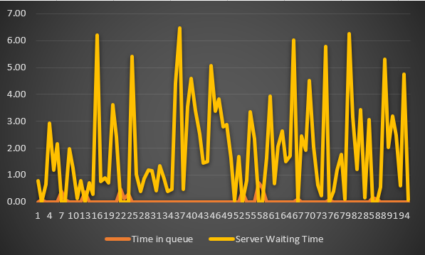
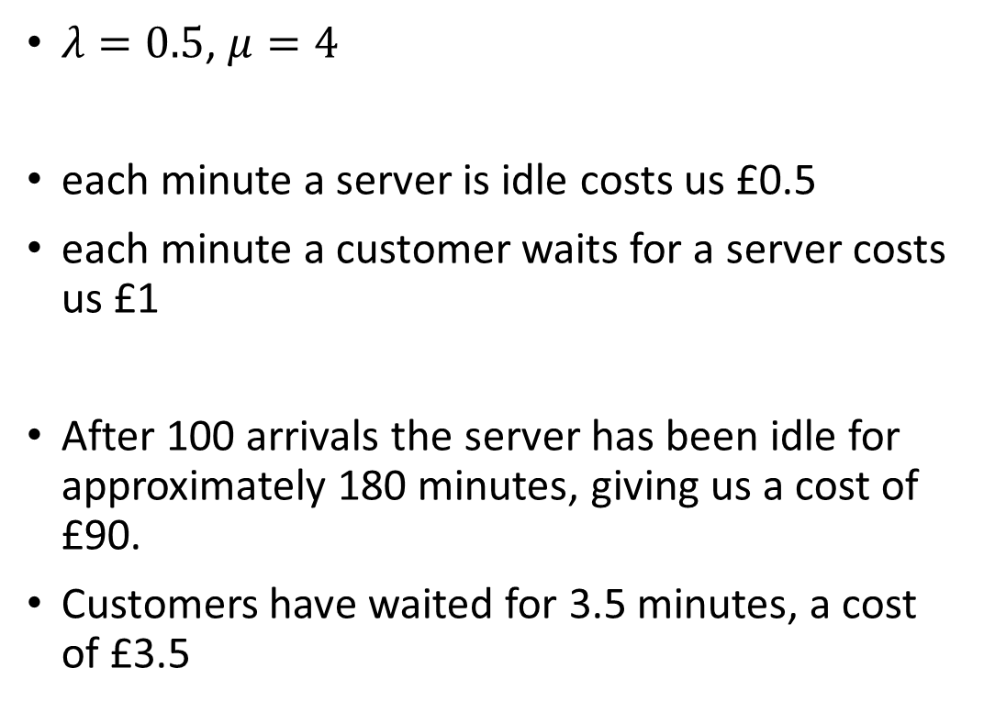
M/M/1 Example
$λ=0.5$, $μ=4$
each minute a server is idle costs us £0.5
each minute a customer waits for a server costs us £1
After 100 arrivals the server has been idle for approximately 180 minutes, giving us a cost of £90.
Customers have waited for 3.5 minutes, a cost of £3.5

Slide 20
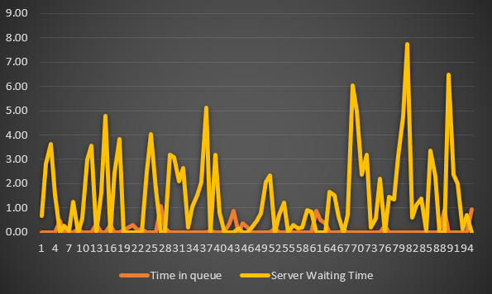
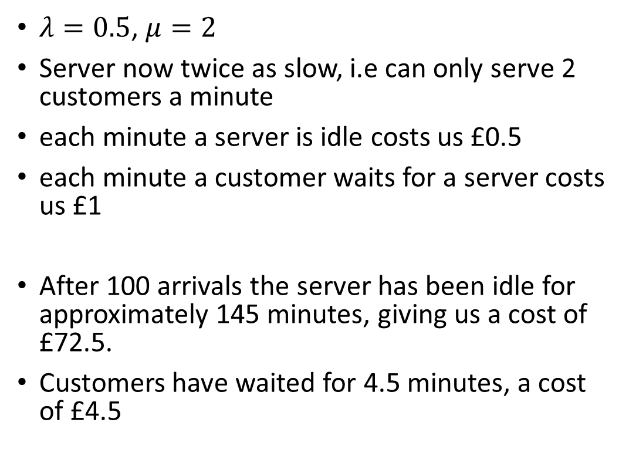
M/M/1 Example
$λ=0.5$, $μ=2$
Server now twice as slow, i.e can only serve 2 customers a minute
each minute a server is idle costs us £0.5
each minute a customer waits for a server costs us £1
After 100 arrivals the server has been idle for approximately 145 minutes, giving us a cost of £72.5.
Customers have waited for 4.5 minutes, a cost of £4.5

Slide 21
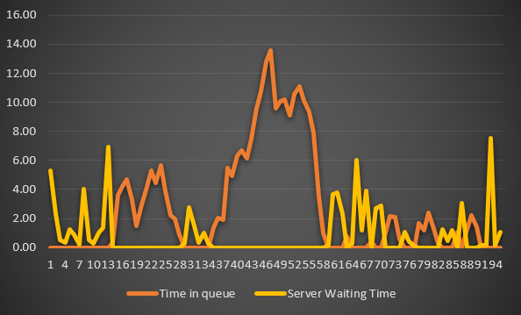
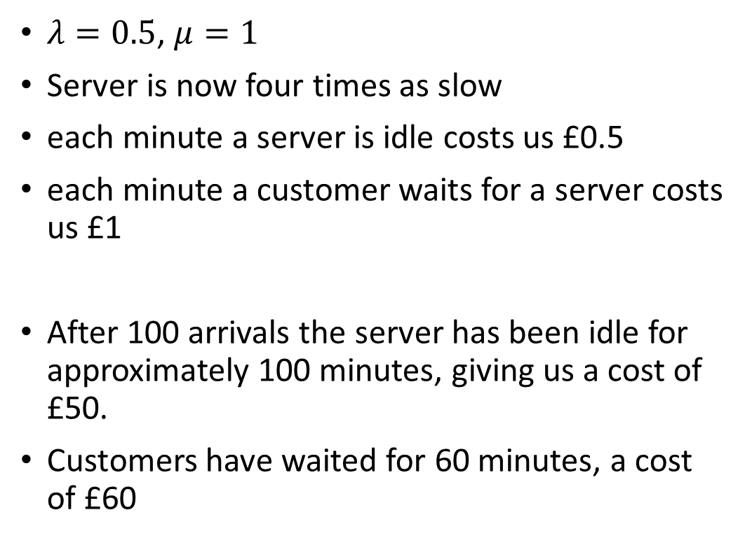
M/M/1 Example
$λ=0.5$, $μ=1$
Server is now four times as slow
each minute a server is idle costs us £0.5
each minute a customer waits for a server costs us £1
After 100 arrivals the server has been idle for approximately 100 minutes, giving us a cost of £50.
Customers have waited for 60 minutes, a cost of £60

Slide 22
M/M/1 Example
Clearly of the 3 cases, case 2 gives the minimum cost
However we have not considered
  Cost of buying new servers/better servers – Should be offset
  New cost of idle server. Maybe the power consumption is higher, or the skilled worker is paid more.
It does however demonstrate that computing waiting times and using associated costs allows you to model and make decisions.

Slide 23
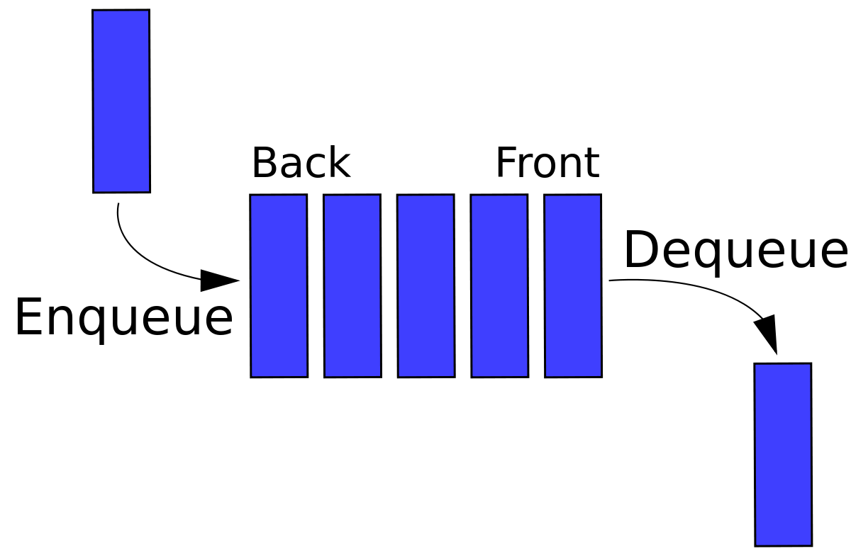
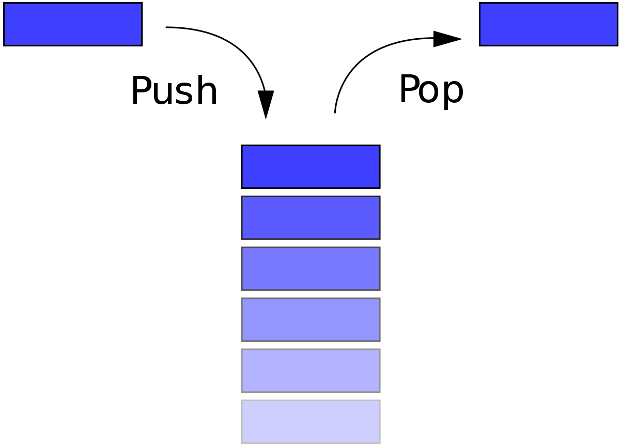
Queue Types (Disciplines)
FIFO – Queueing in line
LIFO – Stack of plates. Tins in a cupboard. Lesson?
FIFO
LIFO

Slide 24
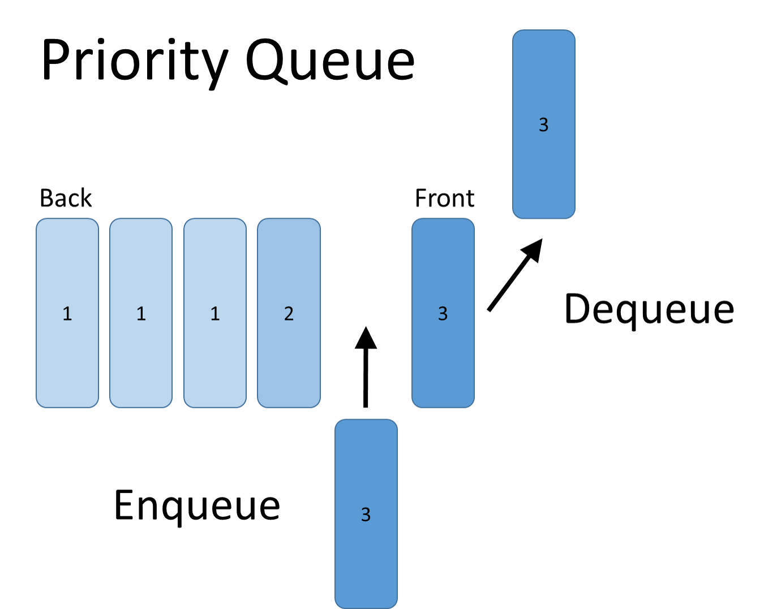
Queue Types (Disciplines)
Priority
FIFO, however you can jump in by your priority.
Real-life example?
A&E!!!

Slide 25
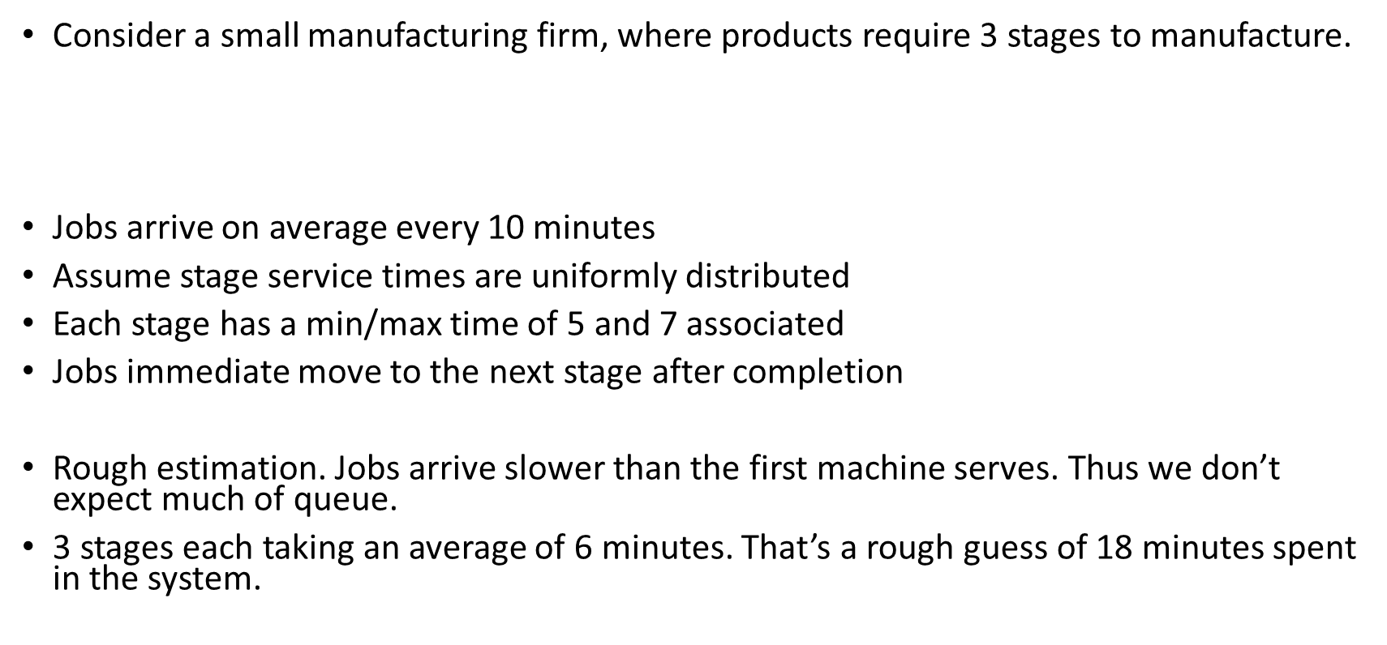
Servers in Series
Consider a small manufacturing firm, where products require 3 stages to manufacture.
Jobs arrive on average every 10 minutes
Assume stage service times are uniformly distributed
Each stage has a min/max time of 5 and 7 associated
Jobs immediate move to the next stage after completion
Rough estimation. Jobs arrive slower than the first machine serves. Thus we don’t expect much of queue.
3 stages each taking an average of 6 minutes. That’s a rough guess of 18 minutes spent in the system.
Queue
Service
Service
Service

Slide 26
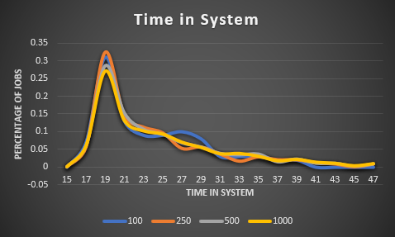
Servers in Series
Simulating in Excel gives the following results for 100,250,500 and 1000 Job arrivals

